Slide 1

Outlier Detection in Healthcare Database

Slide 2
Business Problem
Here we will analyze and detect “Healthcare Provider Fraud” where the provider fills in all the details and makes a claim on behalf of the beneficiary.
Statistics show that 15% of the total Medicare expense is caused due to fraud claims.
Healthcare fraud and abuse take many forms. Some of the most common types of frauds by providers are: a) Billing for services that were not provided. b) Duplicate submission of a claim for the same service. c) Misrepresenting the service provided. d) Charging for a more complex or expensive service than what was actually provided. e) Billing for a covered service when the service actually provided was not covered.

Slide 3
Objective
Use of unsupervised learning was chosen due to a lack to labeled data in the healthcare industry.
Even though the dataset we will be using is a labeled database, but due to industry requirements we will remove its labels and then treat it as an unlabeled dataset to extract outlier points. This label data column will just be used for the evaluation purposes.
Our target will involve hitting a high precision, which will be our evaluation criteria rather than recall due to business constraints as we would rather avoid labelling any non-fraudulent data as fraudulent.
Using unsupervised learning techniques for outlier detection with a target of high precision to extract some useful features.

Slide 4
Dataset Introduction
For this task the dataset that we used was a Kaggle dataset.
It contains 3 datafiles, with In-Patient, Out-Patient and Medical Beneficiary details.
In-Patient data consists of claim details made by Patients that were admitted by the provider.
Out-Patient data consists of claim details made by patients that were not admitted by the provider.
Medical Beneficiary file consists of details of each individual Beneficiary including medical history, annual reimbursement, etc.

Slide 5
Dataset Analysis and Feature Engineering.

Slide 6
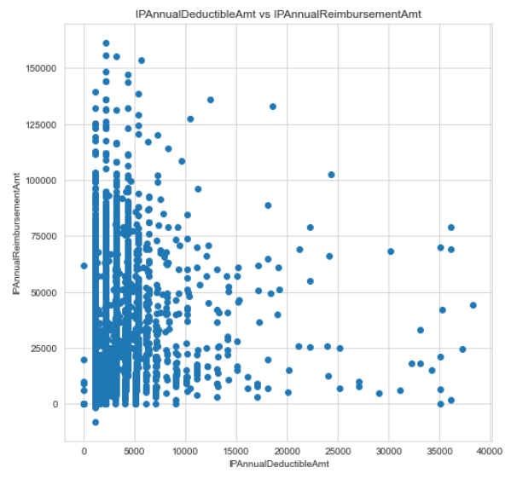
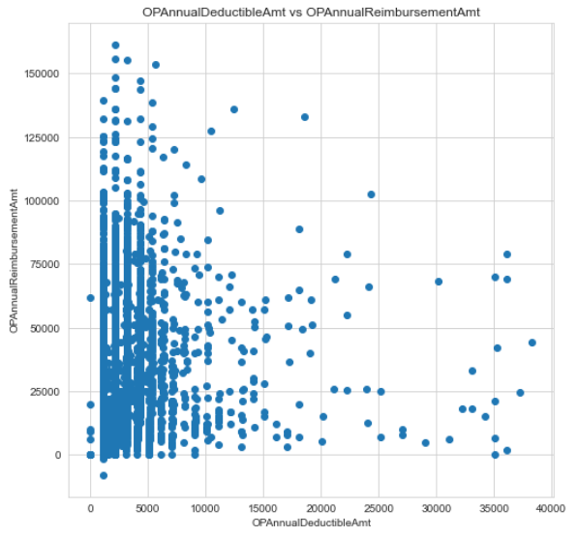
# IPAnnualDeductibleAmt indicated the amount paid by the beneficiary annually for inpatient claim
# IPAnnualReimbursementAmt indicates the reimbursement amount the beneficiary is eligible for per annum.
# Potential erroneous points can lie at the extremities i,e, even though the deductible amount is zero, they got high reimbursements and vice versa.

Slide 7
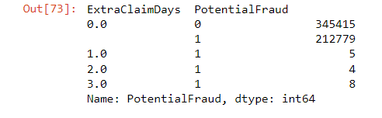
Other Observations from the data..
Another important feature that came out was the claim duration and hospitality duration which was extracted from start and end dates Hospital Admission and Claims, respectively. One possible discrepancy can be the fact when Claim Days are more than the hospitality duration, which in end would turn out to be feature of great importance as all the data entries in which Claim duration > hospitality duration turned out to be outlier points.
OTHER PLAUSIBLE REASONS FOR FRAUD :-
1. Fraud can be at a provider level, as provider fills and submits the claim so we will group by provider and take mean of reimbursed, deducted, etc. If average claim amount or claim period is high for a provider that is suspicious.
2. Beneficiaries also associated with fraudulent activity. So, group the dataframe by Beneficiary Id and take mean. If average claim amount is high for a beneficiary, then this is suspicious.
3. Physicians also associate with fraud so groupBy() physicians also

Slide 8
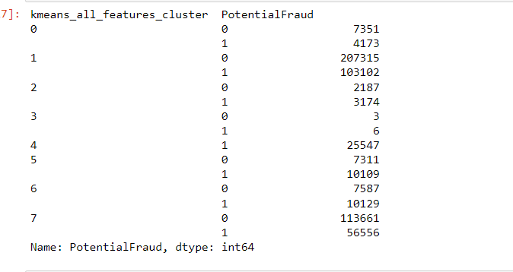
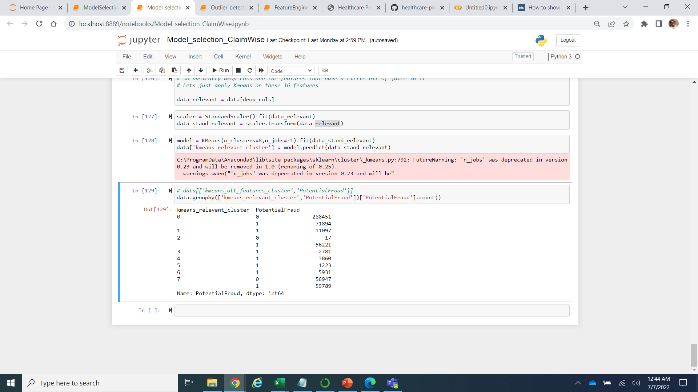
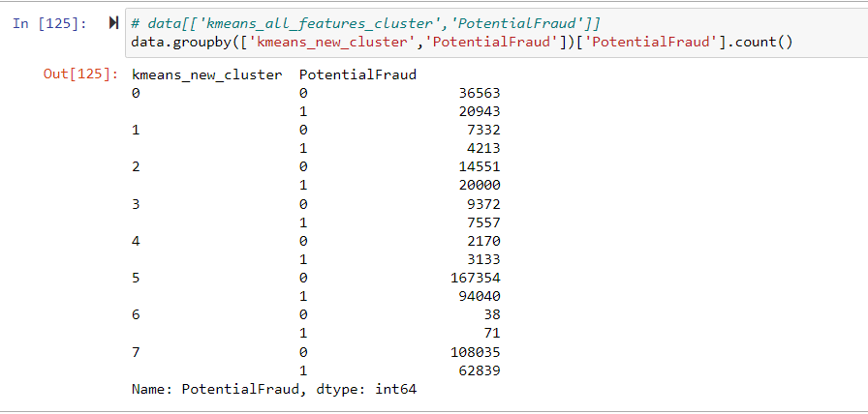
Applying Kmeans on the whole dataset.
Applying Kmeans on the relevant features
Applying Kmeans on the whole dataset except relevant features extracted

Slide 9
Relevant Features extracted.
PerProvider_count_ClaimID
PerProviderBeneID_count_ClaimID
PerProviderAttendingPhysician_count_ClaimID
PerProviderOtherPhysician_count_ClaimID
PerProviderOperatingPhysician_count_ClaimID
PerProviderClmAdmitDiagnosisCode_count_ClaimID
PerProviderClmProcedureCode_1_count_ClaimID
PerProviderClmProcedureCode_2_count_ClaimID
PerProviderClmProcedureCode_3_count_ClaimID
PerProviderClmProcedureCode_4_count_ClaimID
PerProviderClmProcedureCode_5_count_ClaimID
PerProviderClmDiagnosisCode_1_count_ClaimID
PerProviderClmDiagnosisCode_2_count_ClaimID
PerProviderClmDiagnosisCode_3_count_ClaimID
PerProviderClmDiagnosisCode_4_count_ClaimID
PerProviderClmDiagnosisCode_5_count_ClaimID
PerProviderClmDiagnosisCode_6_count_ClaimID
PerProviderDiagnosisGroupCode_count_ClaimID

Slide 10
Using semi-supervised learning

Slide 11
Thank you..

